Slide 1


Titolo presentazione sottotitolo
Granular Synthesis: Granulator 5000
Computer Music Languages and Systems - Assignment 5
Milano, XX mese 20XX
Group ID: NaN

Slide 2
Problem Description & Approach
Challenges:
Foley Sounds for videogames (No direct source for acquisition)
Granular Synthesis
User friendly interface
Method: Three selected Ugens from granular class library SC.
UGen Common Arguments:
numChannels
trigger
dur
maxGrains
Downstream signal treatment:
Latch
Impulse
Normalizer
Downsampler

Slide 3
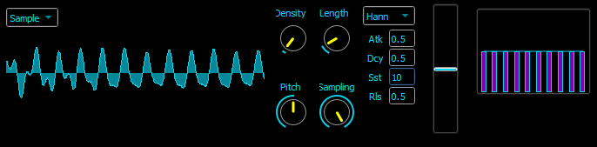
Implementation (1 of 3)
GrainBufSample
External mono or stereo signal stored into a buffer
Dust Ugen – Impulse generator for random grain generation
PlayRate (Pitch control)
Downsampler
Downsampler

Slide 4
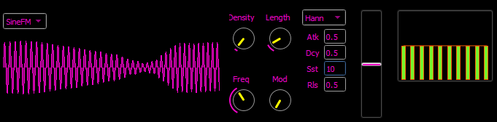
Approach and Implementation (2 of 3)
GrainFMSample
FM synthesized grains
ADSR envelope
Bank of resonant frequencies
Dynklank
Synth envelope
Carrier and Modulator Freq

Slide 5
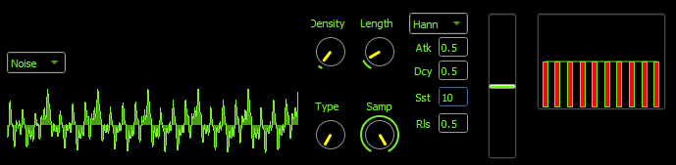
Approach and Implementation (3 of 3)
GrainInSample
Any signal stored in a buffer (Noise)
Adding texture to the output composition
Select Ugen implemented (choosing noise : pink, crackle, White,…)
Downstream: BLowPass UGen (attenuating output freqs)
Grain Smoothing
Noise type selector

Slide 6
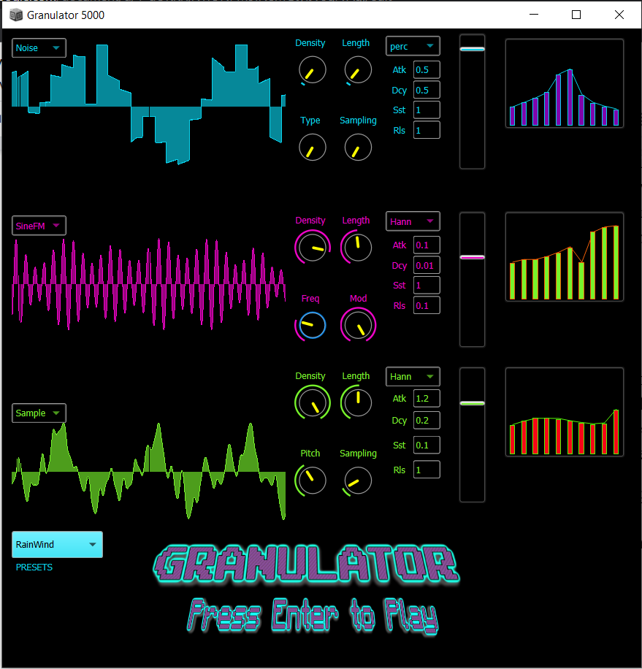
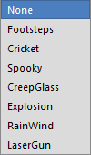
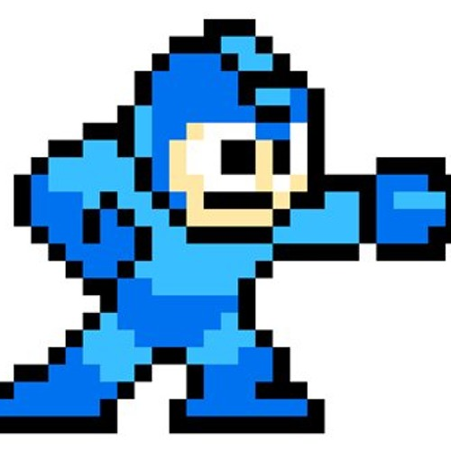
Results
Strip with three adaptable channels
Sound output visualization via ScopeView
Foley sounds obtained loaded as presets
Watch video

